Slide 1

Movie Database
TEAM 4
By Branden Lee, Anh Truong, Alexander Morfin, and Michael Wu
Notes:
Team name and team member
Introduction–a short summary describing the project application
Data Diagram
Flow Chart
A short description of each team member's assignment
Hash function (the actual code) , and pseudocode and examples with typical data, showing collision resolution

Slide 2
Role Description
Michael
File IO
Anh
Binary Search Tree (BST)
Alex
Standard IO
Brad
Internet Movie Database Search
Data Record
Hash Table
Notes:
(1). Add new data
(2). Delete data
(3). Find and display one data record using the primary key
(4). List data in hash table sequence
(5). List data in key sequence (sorted)
(6). Print indented tree
(7). Efficiency
(8). <Team choice menu option>
(9). Quit

Slide 3
Features
Search IMDB online for movies
Search local database using different parameters
Import/export local database from/to file
Add/Delete movies to custom local database
Print out indented tree of movie titles
Show data in the hash table
Display efficiency of various operations

Slide 4
Data
ID No.
Title
Year
Hash Table
Genre
.
.
.
.
Binary Search Trees (3x’s)
Hash Table[0]
Hash Table[1]
.
.
.
Hash Table[n]

Slide 5
User Interaction Flow
Web Returns Movies
User Searches Web For Movie Title
Results Displayed. Movies cached into local database
Local Movie Database
User Searches Local Database for Movie Title
Results Displayed.

Slide 6
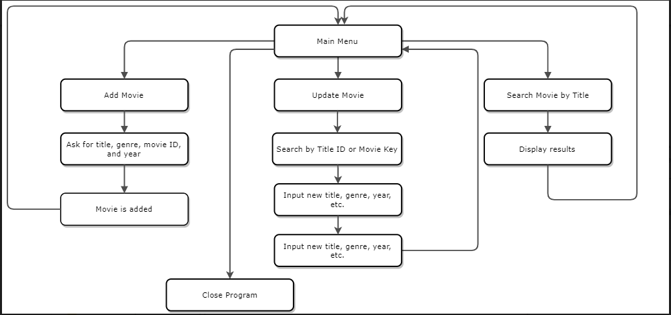
Structure Chart (shortened)

Slide 7
HTTP requests
Server
Client
Internet Movie Database API
Movie Database Program
HTTP GET movies matching “Spider Man”
HTTP response JSON encoded data

Slide 8
File IO
FilePath
Local Movie Database
FileIO::mainStorageToFile (MainStorage *mainStoragePtr, std::string filePath)
FilePath
Local Movie Database
FileIO::fileToMainStorage (MainStorage *mainStoragePtr, std::string filePath)

Slide 9
File IO
Writing Data to File
bool FileIO::mainStorageToFile (MainStorage *mainStoragePtr, std::string filePath)
Getting Data from File into the Program/Local Storage
bool FileIO::fileToMainStorage (MainStorage *mainStoragePtr, std::string filePath)

Slide 10
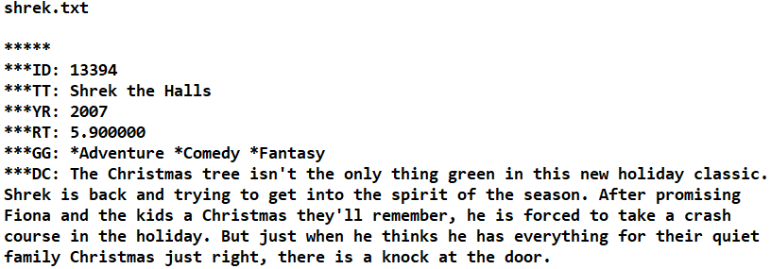
File IO

Slide 11
Movie Insertion
Movie Node:
ID | Title | Year | Key | Genres
559 | Spider-Man 3 | 2007 | Spider_Man_3_2007 | Fantasy, Action, Adventure
TitleIndexTree[10]
YearTree
Hash
Table
GenreIndexTree[2]
iron
2002
drama
home
spider
1999
2007
comedy
fantasy

Slide 12
Movie Title Indexing
Each word indexed in a BST For example:
A Movie Title, With 中文繁體 Characters
movie title with characters
Title Linked List:
movie | title | with | characters
Tree #1
Tree #2
Tree #3
Tree #4
example
text
igloo
job
apple
movie
tastes
title
great
with
characters
kangaroo

Slide 13
Movie Title Searching
Search Query:
thor
Tree #1
Tree #2
Tree #3
Tree #4
thor
star
igloo
job
batman
movie
begins
thor
great
inception
house
kangaroo
Results:
Results:
Final Results:
SQL Equivalent
Union of Search
Search Word | ID
thor | 5
thor | 7
Search Word | ID
thor | 5
thor | 9
Search Word | ID
thor | 5
thor | 7
thor | 9
Notes:
In this example we show a single search query containing a single search term being searched in each of the ten (10) BSTs. In the example, Tree #1 and #2 return a resultset that have a union performed on them to return the final result set.

Slide 14
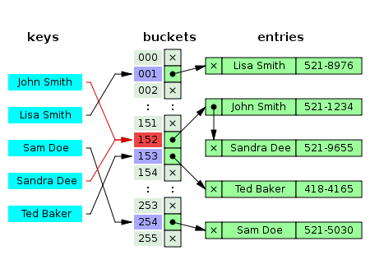
Hash Table
Implemented as a buckets with separate chaining with linked lists
ID | Title | Year | Key | Genres
559 | Spider-Man 3 | 2007 | Spider_Man_3_2007 | Fantasy, Action, Adventure

Slide 15
Hashing Algorithm
#define A 54059 /* a prime */
#define B 76963 /* another prime */
#define FIRSTH 37 /* also prime */
unsigned int StringHelper::hashStr (std::string str, unsigned int size)
{
const char * s = new char[str.length () + 1];
s = str.c_str ();
unsigned int h = FIRSTH;
while (*s)
{
h = (h * A) ^ (s[0] * B);
s++;
}
return h % size;
}
Notes:
We use prime number multiplication in the hsah function to reduce hash table collisions.

